Slide 1
LGE Security Specialist
Studio Project
Team 5 - 5verFlow
Notes:
Hello, everyone. Thank you for being here.
I am WOOLAM KANG, who will present the final presentation of team 5 5verflow.

Slide 2
Contents
Team Members
Roadmap
Phase 1 Review
Phase 2 Security Analysis of Classmate System (Team 6)
Lessons Learned
Notes:
This is the contents of the presentation.
Phase 1 is also included, but we will move on to Phase 2 quickly. We will focus on Phase 2.
I will briefly tell you about the Phase 1, and then we will discuss about Phase 2.

Slide 3
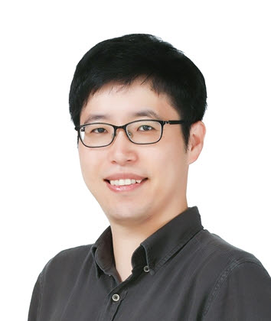
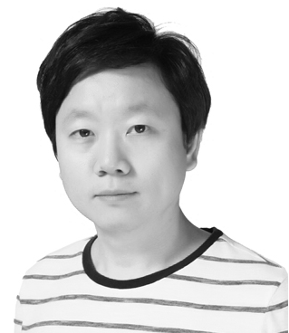
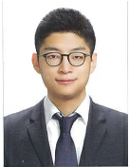



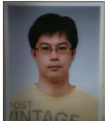
Team Members
Team 5 - 5verflow
pic
pic
pic
SeungWook Cha
(Team Leader)
SungJun Lee
DongHyuk Han
pic
pic
pic
Bradley Schmerl
(Mentor)
WooLam Kang
YooKyoung Choi
YoungJinn Lee
Notes:
First, please let me introduce our team members.
승욱 차 as 팀 리더, 성준 리, 동혁 한, 우람 강, 유경 최, and 영진 리
And there is our great mentor “Bradley Schmerl”.
He was very kind and helpful. Thank you bradley!

Slide 4
Roadmap
To the LG security specialist
Orientation
Feb `21
CMU e-learning
Apr `21
CMU Phase 1
Jun `21
Security Fundamental
vulnerability, SW engineering, secure coding
Introduction
Weekly Live Session
Team Building
e-Lecture & quiz
Studio Project
jetson nano, face recognition
LG
Security
Specialist
5verFlow
Weekly Live Session
Cyber Security
cryptography, Web, Network, Secure Coding
Security Testing
secure coding 2, exploitation, penetration, tools
Software Security
Security Engineering
threat modeling, secure design, fuzz testing, malware
Studio Project
Project evaluation
Coursera
Mar`21
KR live class
May `21
CMU Phase 2
Jun `21
Notes:
This is the roadmap to the LG Security Specialist. We had learned many security classes, including this CMU remote class.
Phase 2 is the main part of the presentation.
In phase 2, testing, release, and responding to security are processed.

Slide 5
Phase 1 Review
Notes:
First, let’s look at phase 1 briefly.
=========================
Then let’s look at phase 1 briefly and quickly.

Slide 6
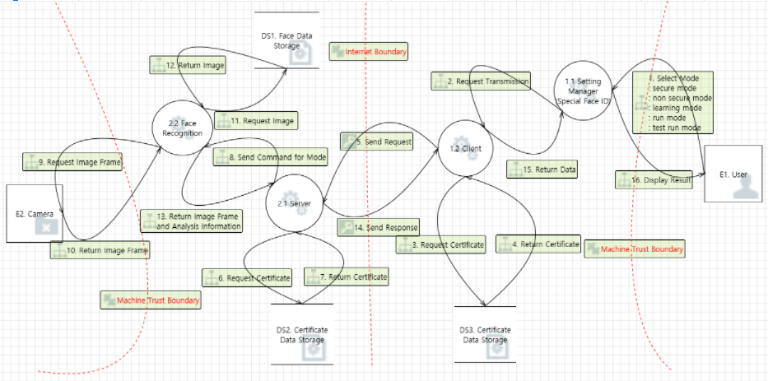
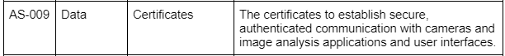
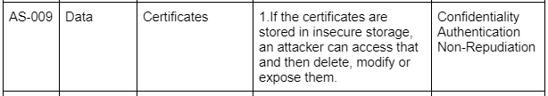
Requirement
Phase 1 Review
Requirement Analysis
STRIDE
OWASP
Six-part Quality Attribute Scenarios
Asset Identification
Threat (Vulnerability) Analysis
Security Risk Assessment
Mitigating Threats
1. User RQ
2. Project RQ
3. SW RQ
4. SW, HW
1. Asset list
2. DFD
1. Threat
1. Security
Risk Level
1. Security Req.
<Asset List>
<DFD>
Notes:
At first of phase 1, we analyzed requirements. We derive asset list, DFD, and threat model.
----------
At first of phase 1, we analyzed requirements for functionality, derived asset list, and DFD.
Second, we made threat model from DFD with MS threat modeling tool.

Slide 7
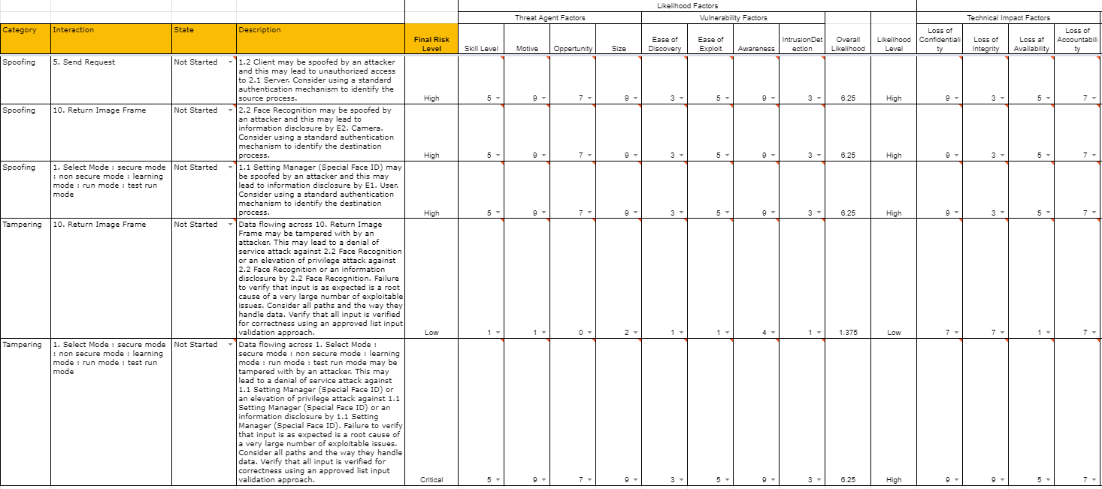
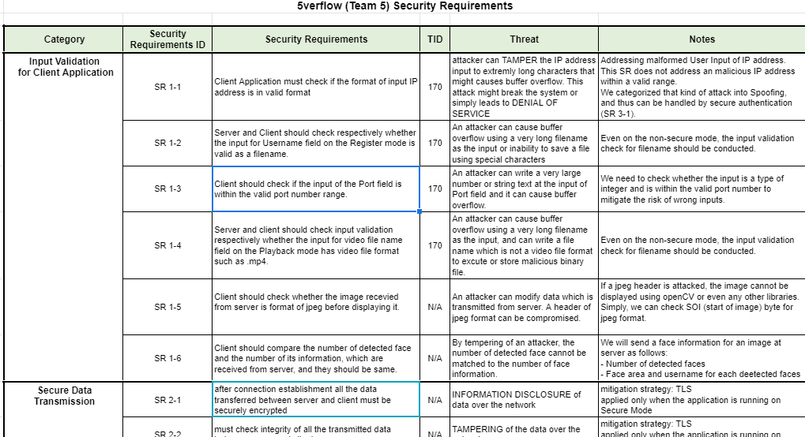
Requirement
Phase 1 Review
Requirement Analysis
STRIDE
OWASP
Six-part Quality Attribute Scenarios
Asset Identification
Threat (Vulnerability) Analysis
Security Risk Assessment
Mitigating Threats
1. User RQ
2. Project RQ
3. SW RQ
4. SW, HW
1. Asset list
2. DFD
1. Threat
1. Security
Risk Level
1. Security Req.
<Security Risk Level>
<Security Requirement>
Notes:
Then we selected 19 threats from the modeling result, and assessed the risks with OWASP. Finally, we made a security requirement.
----------
At third, we selected 19 threats from the modeling result and we categorized them as 5 categories to define risk.
We assessed selected risks with OWASP methodology.
At last, we discussed how to mitigate risk and related quality attributes.
Finally, we made a security requirement.

Slide 8
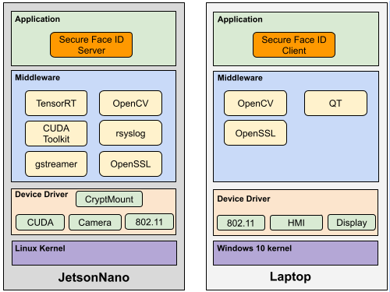
Secure Design
Phase 1 Review
Write invalid form of IP address (ex. 123.456.789)
Input Validation : Input Data Verifier
Sniffing data on network between JetsonNano and user laptop
Data Encryption : OpenSSL v1.1
Connection from unknown client
Authentication : Key from trusted certificate authority (JetsonNano)
Secure Storage
cryptmount
Logging
rsyslog
Software Architect Design Document : https://docs.google.com/document/d/1NJaph-tavyyWxa13gYBciuc1nuE-puGsy08pcuRcfRk
Notes:
It shows our secure design overview of the server and the client.
=================================
Three main items for our security design are emphasized by colored border lines.
first, input validation for an invalid form of IP address and user name.
second, Data Encryption using OpenSSL and Authenticating with trusted authorized certificates.
third, Secure storage to store valuable assets, such as key and image.
Secure storage is implemented using cryptomount .
In addition, connection logging with rsyslog is included.

Slide 9
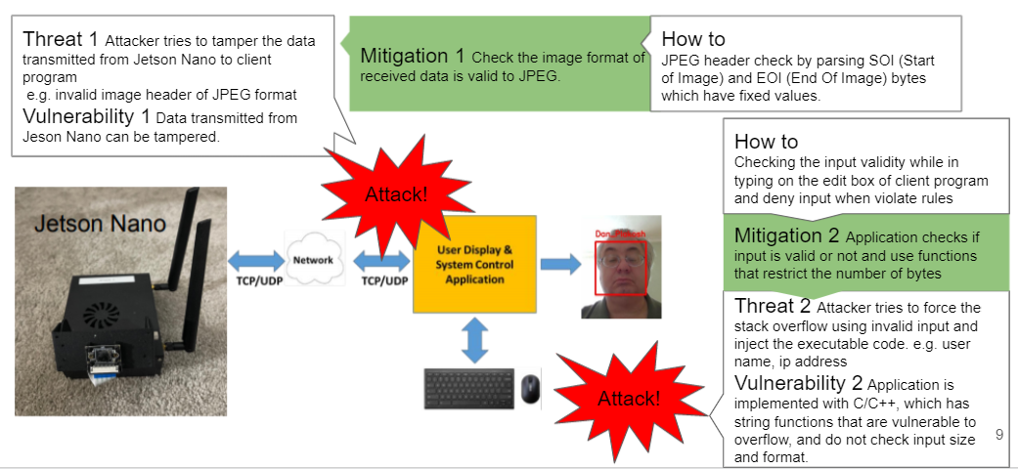
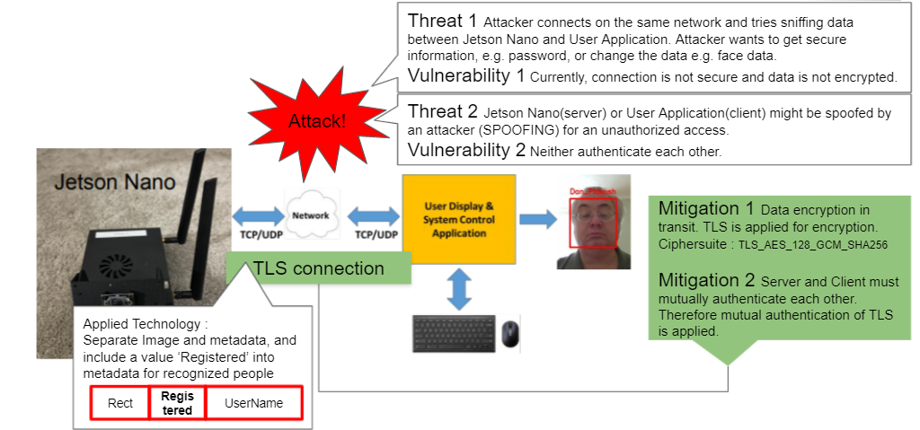
Secure Design
Phase 1 Review
Input Validation
Data Transmission
Notes:
Here is some examples of our design to mitigate security risk.
input validation and data transmission.
I will skip the detail for the sake of time.

Slide 10
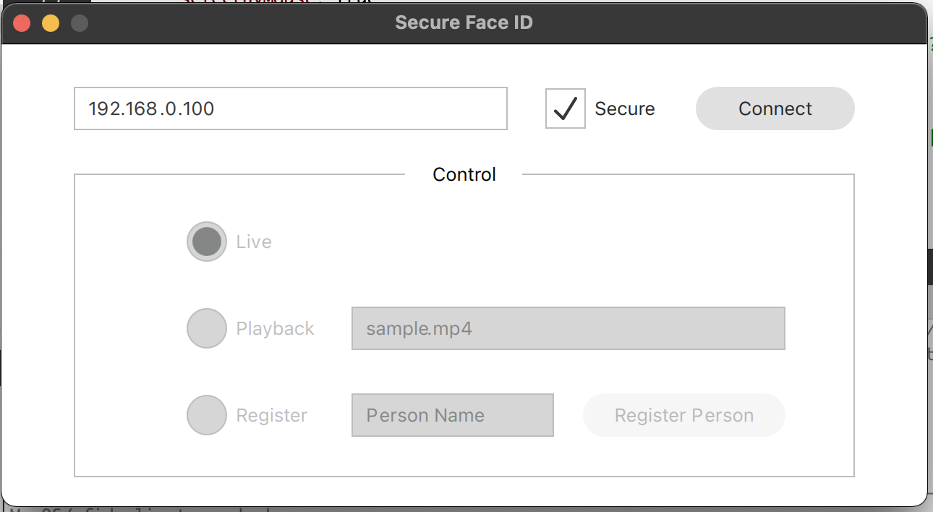
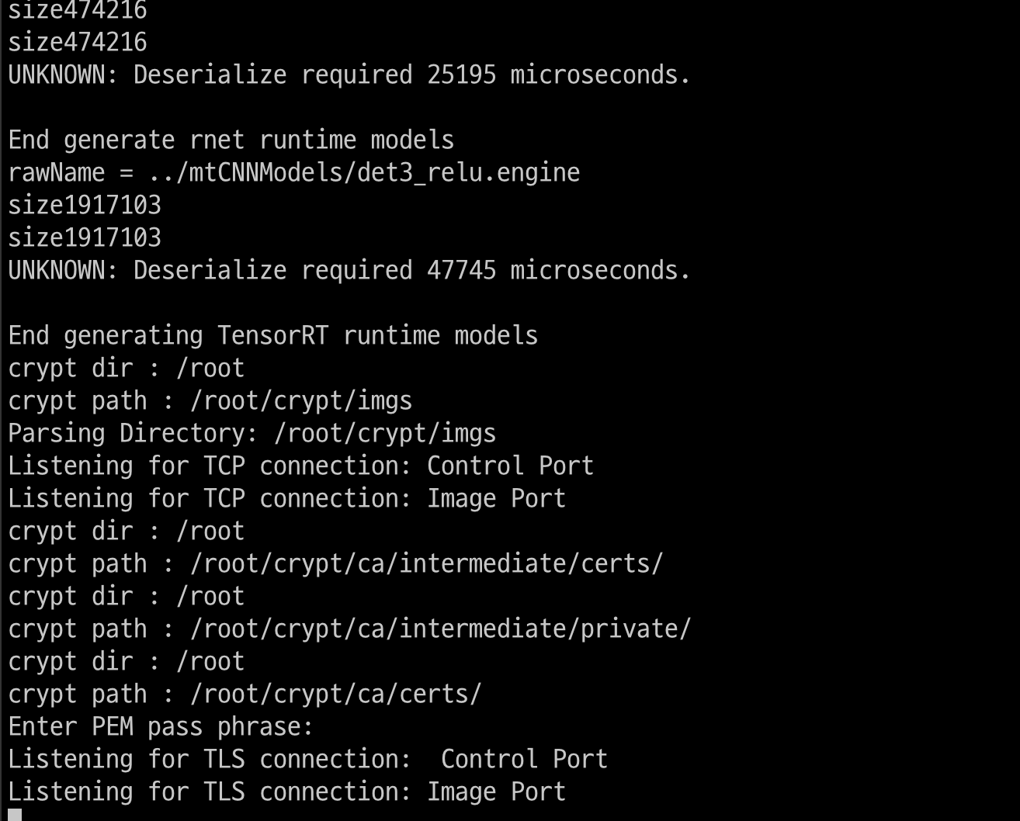
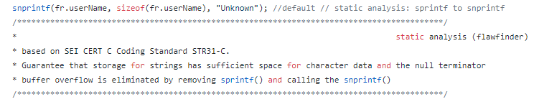
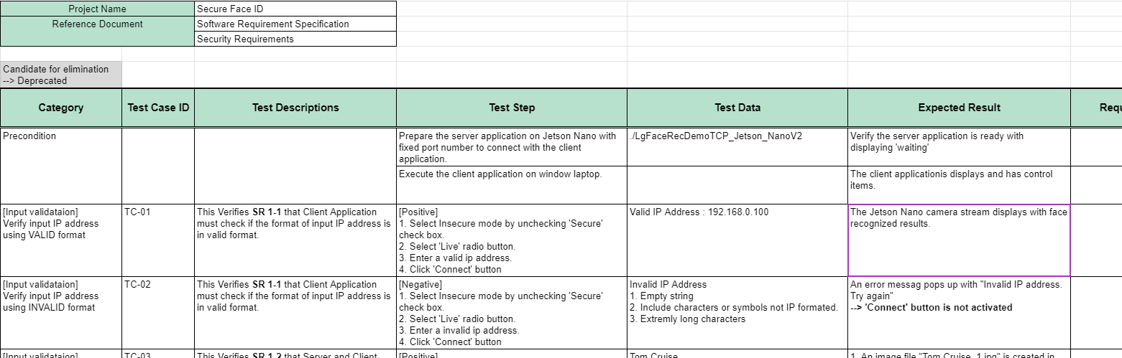
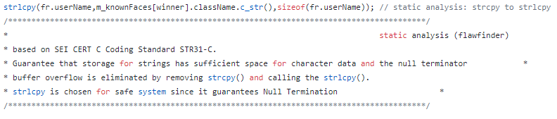
Implementation & Verification
Phase 1 Review
<Client>
<Server>
Secure Coding w/ Static Analysis
FlawFinder : 21 issues found -> fixed!
Verifications w/ 20 Test cases
Notes:
After the design phase, we implemented our client and server.
Some libraries are applied such as Qt framework for GUI, OpenSSL for secure transmission.
During implementation phase, also performed static analysis using FlawFinder and CppCheck to check issues and fixed them.
----------
next to the design,
we kept following secure coding by conducting FlawFinder and CppCheck.
also we tested focused on secure test cases.

Slide 11
Phase 2
Security Analysis of Classmate System
Notes:
Then we are going to look at phase 2.

Slide 12
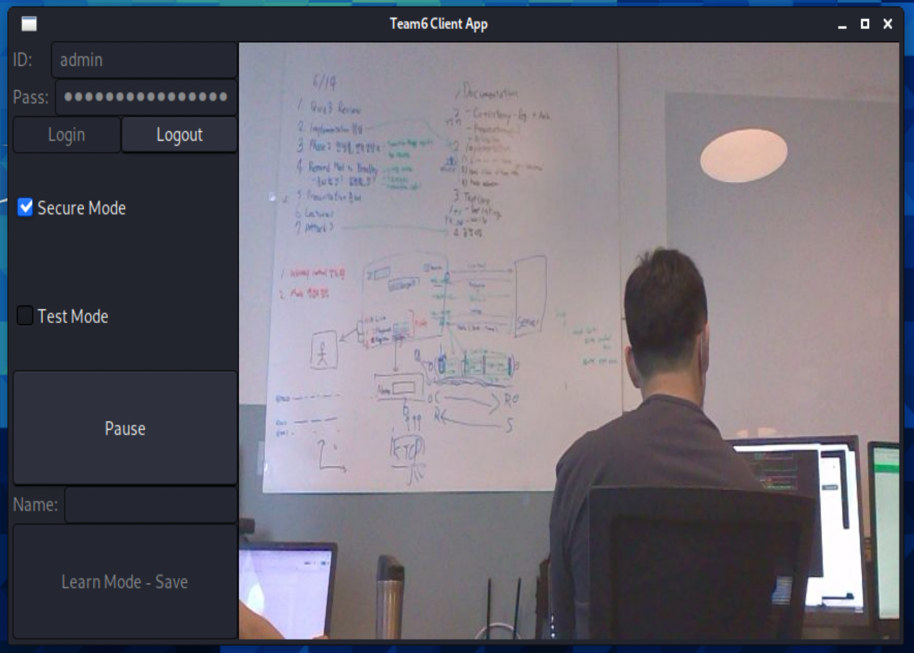
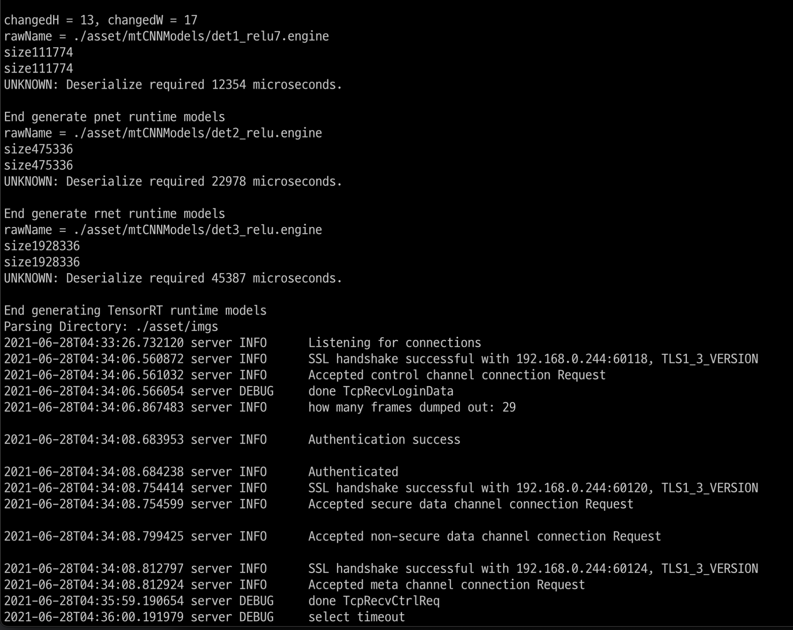
Introduction of Team 6’s System
Phase 2
Our review from the presentation of phase 1 and the given artifacts
Assumes that only one ID/PW is allowed and faces for ID are pre-registered.
2 factor authentication is used to log in (ID/PW, face)
All the faces are stored with encryption. even the filename is hashed value as well.
Communicate using Encrypted channel with TLS protocol.
Team 6’s Client UI
Server is always printing the log
<Client>
<Server>
Notes:
In phase 2, we had to do a security analysis of Team 6's system.
Before we performed detailed analysis, we briefly reviewed the Team 6’s presentation of phase 1 and the given artifacts.
As a result of our review, team 6's system had the following characteristics.
… < 4문장 읽지 않음 >
The UI of the client and server is as shown.
The client has a GUI using GTK, and the server doesn’t have GUI. It is just console application and prints the log.

Slide 13
Found Vulnerabilities - Categorized by Methods
Phase 2
Method | # of founding | Takeaway
Manual Code Review | 17 | Source code has full and correct information about the software Good to find security holes for attackers accustomed to programming languages Risks on this method are: Illegible code might be almost impossible to read Takes time to understand without documents
Documents | 8 | Well-organized information to the program Security-related documents are useful to find out what have been neglected. Risks on this method are: If a document is not written well or not updated for the latest commit of source code, it might misguide the reader.
Tests | 4 | Developers have already run several tests - using another tools is recommended Requires knowledge and environment setups for testing Risks on this method are: Takes time for preparations
Total | 29
Notes:
Let me introduce the vulnerabilities we found, before explaining the detail of our analysis process.
As you can see, we’ve found twenty-nine vulnerabilities.
Most of them are earned from code review. as we developers are familiar with C and C plus plus, we got many information from source code.
we found eight vulnerabilities from document, because it is easy to look up security concerns
we only got four from static and dynamic tests, as team six have already worked on it.

Slide 14
Found Vulnerabilities - Categorized by CIA triad
Phase 2
CIA | # of founding | Takeaway
Availability | 16 | Most of the exploitable vulnerabilities are to harm availability as Just breaking a software does not require full understanding of it The attacks are out of coverage the application handles (OS or router’s role), from our experience in phase 1
Integrity | 5 | Found some vulnerabilities, but most of them failed since Data on transmission is protected by TLS Data in filesystem is protected by encryption (hashed)
Complex | 5 | Some of the vulnerabilities affect multiple components. E.g., weak SSH ID and password leads to penetration that enables numerous attacks
Confidentiality | 3 | It was hard to find out exploitable vulnerabilities due to TLS covers many vulnerabilities related to confidentiality two-factor authentication
Total | 29
Notes:
Here is another table that shows the categorization of vulnerabilities based on their effects on the CIA triad.
Most of the vulnerabilities affects availability, as they are easy and does not require deep understandings of target software.
The second is to attack integrity, but data encryption blocked most of our attacks.
Some of the vulnerabilities affect two or more CIA components.
For example, weak ID and password leads to penetration, then the attacker can do everything such as write file, modify log, or delete data.
Attacks on confidentiality are also small in number, because TLS and two-factor authentication protect the system

Slide 15
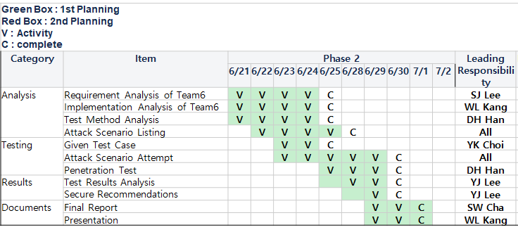
Red Team Activities
Phase 2
Schedule
Activity
Analyze documents
Threat modeling
Security requirement
Design document
Static analysis result
Conduct test cases
Given test cases
Additional exploring test
Code reviews
Write sequence diagram
Secure perspectives
Discuss attack scenario (Periodically)
Do attack
based on our vulnerability hypothesis
Wrap Up
Team Organization
Name | Role (Phase 2)
SeungWook Cha | Team Lead
SungJun Lee | Document Analysis
DongHyuk Han | Document Analysis & Secure Testing
WooLam Kang | Implement Analysis & Secure Testing
YooKyoung Choi | Document Analysis & Secure Testing
YoungJinn Lee | Implement Analysis & Secure Testing
Notes:
Now I will explain the detail of our analysis process to find these vulnerabilities.
Prior to the analysis, we planned a new schedule and assigned each role for phase 2.
And we perform these security analysis activities including attack trials.
----------
Based on the artifacts received from the team 6, we analyze the documents by comparing them with what we did in phase 1, perform the given TC, and check the vulnerabilities that were suspected in the analysis process. We want to verify whether the mitigation is successfully applied through this task. We also looked for any missing vulnerabilities.
We wrote an attack scenario for the vulnerabilities found and actually performed the attack.
코드 분석으로 얻어낸 Sequence Diagram을 바탕으로 시큐어 관점에서 주요 로직에 대한 코드 리뷰를 수행하면서 심도 깊게 취약점을 찾아내려 노력하였다.
발견한 취약점들에 대해 공격 시나리오를 작성하고 실제로 공격을 수행해 보았다.

Slide 16
Analysis : Team 6’s Development Process
Phase 2
Security items found in Team 6’s docs → Discussion points
Requirement
Design
Implementation
Test
Secure Mode
2 Factor Authentication
User Credentials
Encrypt data by using TLS/AES/SHA256
Mutual authentication
Input sanitize
FlawFinder
CppCheck
Binary obfuscation
9 functional test cases
No security test cases
In Team 6’s artifact, there is no security test case.
Vulnerability
We(Team 5) didn’t apply binary obfuscation in phase 1.
Data Exposure
Communication
Goal
Protect PII !
* PII : Personally Identifiable Information
+ Violet : Team 5’s missed item
- Gray : Team 6’s missed item
Notes:
By analyzing given artifacts, we summarized security issues discussed at each stage of development in Team 6.
Binary obfuscation is remarkable feature.
And it would be better if they added security test cases.
----------
Requirement : 요구 사항을 분석하면서 Secure Mode, 2 FA, User Credentials에 주목했고, 요구사항 도출과정에서 Data Exposure와 Communication이 취약함을 발견, 특히 개인정보를 보호하는 것을 Goal로 지정함. 이후 Threat Modeling하고 STRIDE와 P&G 등의 기법으로 위협을 분석하고 OWASP으로 위험 평가를 수행하여 최종 Security Requirement를 도출
Design : 요구사항 만족을 위해 TLS 및 AES와 SHA256을 이용하여 data flow와 user data를 encrypt하는 design과 mutual authentication및 input sanitize를 적용
Implementation : 역공학을 대비해 코드 난독화 적용하고, flawfinder와 cppcheck을 이용하여 static analysis를 반복 수행하여 secure coding을 준수
Test : 9 개의 Functional TC 수행

Slide 17
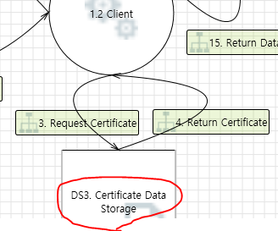
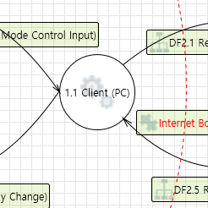
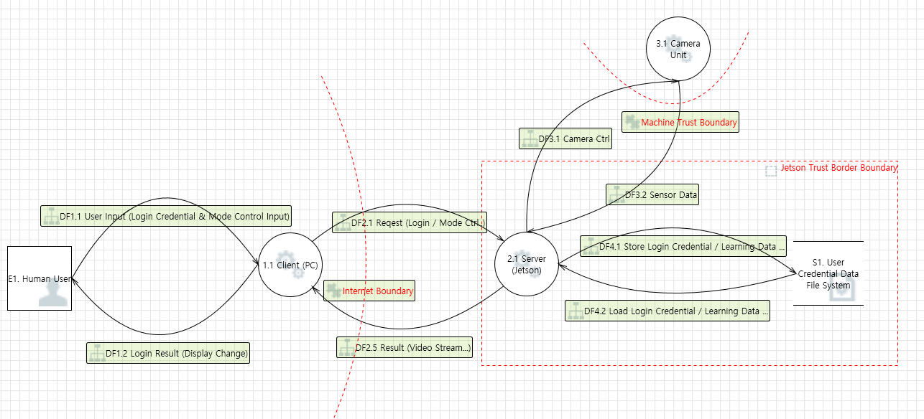
Analysis : Team 6’s Threat Model
Phase 2
Vulnerability : On the client side, secure storage is not considered.
Team 5
Team 6
no secure storage
on client side
VS.
Team 6’s DFD
Vulnerability
[ This DFD considered the secure storage ]
Notes:
Let’s dive into more detail about team 6’s artifacts.
From Team 6’s threat model, we found that there are no secure storage on client side.
We wrote the attack scenario with this vulnerability. This will be discussed in detail later.
----------
여기서 표시한 Attack point는 뒤에서 자세히 설명할 것이다..
DFD 분석 결과 Client측에서의 Secure Storage 고려가 되어있지 않았고, 이를 토대로 Attack Case 1을 도출하였다. (Attack 1 - remote.config)
TBD: 빨간 테두리는 Team 5 -> Team 6와의 차이를 보이기 위함

Slide 18
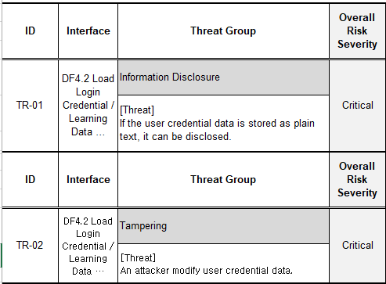
Analysis : Team 6’s Risk Assessment
Phase 2
‘Input Validation’ was most critical in our case, however, Team 6 Assessment shows ‘User Credential’ as critical and we reviewed focused on it and found that mitigation was applied well.
Next, we’d tried looking for vulnerabilities in the Input Validation area but there was no remarkable result. Input Validation was marked as High in the Team 6 assessment and it looks like well mitigated.
Notes:
From Team 6’s risk assessment, we selected some risks classified as critical, extract vulnerabilities related to those, and made attack scenarios.
But there was no successful attack because Team 6 had applied the mitigation well.
----------
critica로 분류된 risk와 관련된 vulnerabilites들을 몇개 추려 공격 시나리오를 짜보았으나 대응이 잘 되어있어 성공한 공격은 없었다.
대신에 잘못된 credential을 주입하여 프로그램의 malfunction을 발생시키는 것에는 성공하였다. Attack XXXX
Security Requirement도 이를 토대로 작성되어진 것이라 새로운 vulnerability는 찾을 수 없었다.

Slide 19
Analysis : Static Analysis
Phase 2
Team 5 did
1. Run static analysis and Find vulnerabilities.
2. Analyze and Evaluate each item.
3. Suggest mitigations for vulnerabilities.
4. Try to attack !!
Encoding data without null character, then restart server. ⇒ Terminated abnormally.
FlawFinder ID | Source code path (line) | Target | Vulnerability code | Analysis of Team 5
FF-01 | ./common/TcpSendRecv.cpp:124 | (buffer) memcpy | CWE-120 | need mitigation - alloc size of dst
FF-04 | ./server/src/faceNet.cpp:122 | (misc) open | CWE-362 | Follow the principle of least privilege when assigning access rights to entities in a software system. Denying access to a file can prevent an attacker from replacing that file with a link to a sensitive file.
FF-08 | ./server/src/main.cpp:163 | (buffer) memcpy | CWE-120 | false alarm
FF-09 | ./common/TcpSendRecv.cpp:99 | (buffer) strlen | CWE-126 | false alarm the parameter userid((const gchar*) is called with c_str() which always contains null termination
FlawFinder
can find
uses of risky functions, buffer overflow (strcpy()), format string ([v][f]printf()), race conditions (access(), chown(), and mktemp()), shell metacharacters (exec()), and poor random numbers (random()).
CppCheck ID | Sourcecode path (line) | Type | Analysis of Team 5
CC-01 | server/src/main.cpp:196 | style [unreadVariable] | false positive
CC-07 | server/src/videoStreamer.cpp:35 | warning [noCopyConstructor] | false positive - use openCV library
CC-08 | server/src/videoStreamer.cpp:35 | warning [noOperatorEq] | false positive - use openCV library
CC-09 | server/src/videoStreamer.cpp:60 | style [unusedFunction] | unused. if not in use, delete it.
CC-13 | common/Logger.cpp:124 | style [unusedFunction] | false positive
CppCheck
can find
pointer to a variable that goes out of scope, bounds, classes (missing constructors, unused private functions, etc.), exception safety, memory leaks, invalid STL usage, overlapping data in sprintf, division by zero, null pointer dereference, unused struct member, passing parameter by value
Top 5 violations
Violated Rules | counts | Rule
cppcheck:misra_c_2012_15_01 | 119 | The goto statement should not be used
cppcheck:misra_c_2012_14_04 | 88 | The controlling expression of an if-statement and the controlling expression of an iteration-statement shall have essentially Boolean type
cppcheck:misra_c_2012_15_05 | 86 | A function should have a single point of exit at the end
cppcheck:misra_c_2012_15_06 | 65 | The body of an iteration-statement or a selection-statement shall be a compound statement
cppcheck:misra_c_2012_12_01 | 59 | The precedence of operators within expressions should be made explicit
Code x-ray
* LG’s internal tool (MISRA C 2012) * Supports the detection of security vulnerabilities. * Compatible with security standards such as CERT, CWE, OWASP, SANS Top 25, OWASP Top 10, and more.
if (i){ // non compliant
}
if (i != 0){ // compliant
}
Notes:
Team 6 used FlawFinder and CppCheck for static analysis.
As the same, we conducted a static analysis using FlawFinder and CppCheck to list vulnerabilities. Then we assess each vulnerability and suppose the mitigation.
Also, we tried to exploit the vulnerability of “strlen” function, by encoding data except for null character, used as the separator between username and image data. The server terminated abnormally after restart because “strlen” function cannot separate username and image data without null character.
In addition, we analyzed using Code X-ray which is LG internal static analysis tool. The result contains over 500(five hundred) with MISRA standard.
Since the target of MISRA is the motor industry, the rules seem to be more tight.
----------
6팀에서 수행한 static analysis tool인 FlawFinder와 Cppcheck를 실행하여 vulnerability를 리스팅하고, 각 항목을 평가하여 mitigation이 필요한 부분에 대해 description을 적었다.
6팀이 이미 활용했기 때문에 critical issue는 발견하기 어려웠다.
추가로, LGE에서 내부적으로 사용하는 static analysis tool인 code x-ray를 이용해보았는데, MISRA standard를 적용하면 500개 이상의 취약점이 나왔음.
MISRA가 Motor Industry가 target이라 safety를 고려해 sensitive하게 체크하는것 같고, MISRA 2012 14.04 rule 처럼 if statement가 boolean형식이 아닌 경우에도 violation으로 검출하는 것을 확인할 수 있었다.
더 tight하게

Slide 20
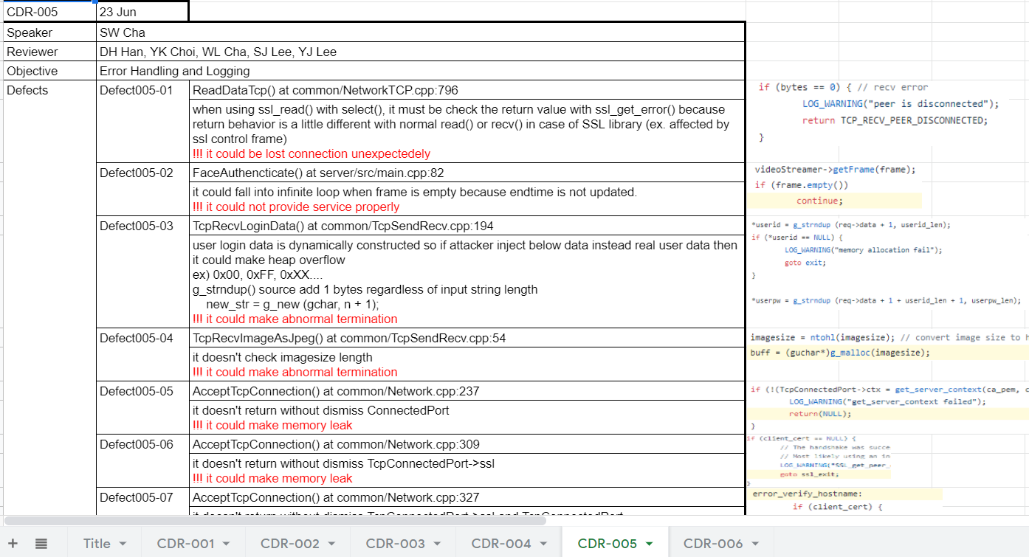
Analysis : Manual Code Review
Phase 2
We'd conducted a code review on each module categorized by objective.
File Management
Input Validation
Authentication and Password Management
Session Management
Error Handling and Logging
Communication Security
https://docs.google.com/spreadsheets/d/1sCAtsdGnupTEm-SJymMjXAJZx7G2cgQ5aBmfEt2TdWU/edit#gid=1988357498
Notes:
We'd conducted a code review on each module categorized by objective, and derived some attack points.
These points will be discussed in detail later.
----------
우리는 아래와 같은 주제를 지정하여 코드 리뷰를 수행하였고, 이 과정에서 Attack XXX를 도출하였습니다.

Slide 21
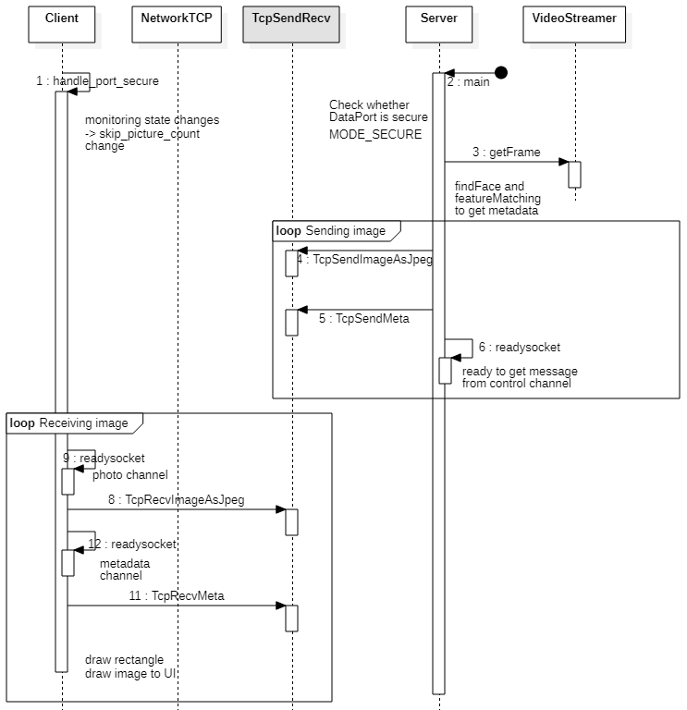
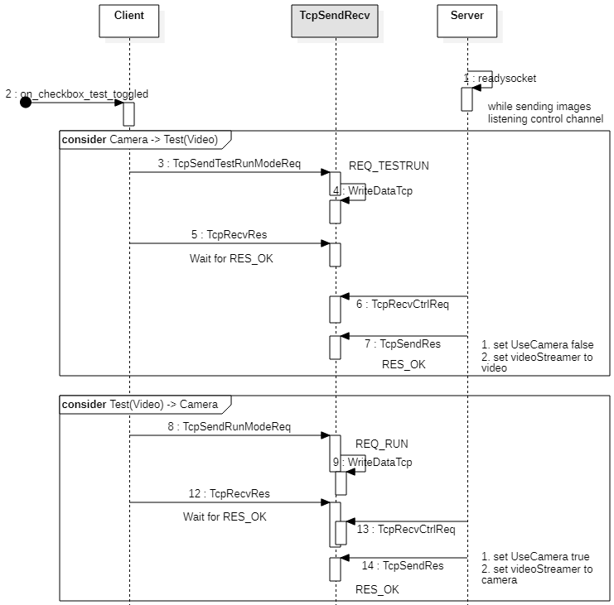
Analysis : Manual Code Review (Sequence Diagram)
Phase 2
Deep analysis of code in sequence diagrams helped find vulnerabilities. e.g. attack case 1~4
<Data Communications>
<Changing Run Mode>
Notes:
In the code review process, we created sequence diagrams to better understand the system operation.
Here are two sequence diagram samples for Data Communications and Changing Run Mode.
----------
System 동작을 이해하기 위해 각 step에서 server와 client간 interaction(or work)을 sequence로 그렸음.
Server/Client Initialization, LogIn, Data Communications, Secure Mode Change, Play Mode Change, Switch to Learn Mode, Save on Learn Mode
그 중 한 예제로 Data communication, Play mode change.
Data communication에서는 image와 metadata를 분리해서 보내는 방법을 확인.
Play mode change에서는 client가 control channel을 통해 Play mode 혹은 test mode를 요청하면, server에서는 받은 것에 대한 응답을 주고, stream을 전환하는 동작을 수행하는 것을 확인

Slide 22
Attack Scenario
Phase 2
Attack Scenario - 11 of 29 scenarios are tested
Assessment using two factors
Attack Impact - Private info. is the most important
Attack Difficulty - How easy to try
ID | Reconnaissance Phase | Condition | Vulnerability | Attack Scenario | Attack Impact | Attack Difficulty | Attack Priority | How to test? | Threat (Expected result by attack) | Status
AS-00 (example) | How did we find out? (Analysis documents, Code Review, nmap, packet sniffing, Nessus, etc.) | Reproducible Situation (e.g., Server Application runs with ./LgFaceRecDemoTCP_Jetson_NanoV2 20000 (invalid port num)) | Vulnerabilities found (e..g, Server Application does not allow a port except 5000) | Attacking scenario (e.g., Run a daemon which occpies port 5000) | Grading : 1~5 1 : low impact 5 : high impact | Grading : 1~5 1 : hard 5 : easy | Priority = Impact x Difficulty | Test Tool (Metasploit, Zuff, Peach, etc.)
AS-15 | Team 6 Artifacts - Source Code : Manual Code Review | during connection establishing | Sniffing - there are 4 sockets in a port to connection but log in is conducted only in first socket. | timing attack it could be sniff if attacker connect to another socket after first socket is connected. | 5 | 5 | 25 | Timing attack by giving a delay such as sleep, input, etc. | extract video from camera | Attack Success
AS-13 | Team 6 Artifacts - Source Code : Manual Code Review | run the client app | Denial of Service, Information disclosure server IP in remote.config file is a plaintext | immune the remote.config file by mutating fuzzy | 4 | 5 | 20 | 1. Use ZZUF to compromise remote.config file 2. Open client application w/ compromised remote.config file | A client application terminated | Attack Success
AS-30 | Team 6 Artifacts - Source Code : Manual Code Review | when press 'pause' button to enter Learning mode | Any faces can be the candidate to save no matter what if the face is already registered. That is, a person can have different names | Try to save recognized faces again with another name | 4 | 5 | 20 | 1. Save a face 2. press pause button when that face is shown and recognized. | already recognized face is saved again with different name | Attack Success - Already recognized face can be saved again with another name
AS-16 | Team 6 Artifacts - Source Code : Manual Code Review | during connection establishing | Same as above (AS-15) | timing attack If we keep trying to connect, your connection will be confused. | 3 | 5 | 15 | Timing attack by giving a delay such as sleep, input, etc. | DoS. Server dead. | Attack Success
Notes:
Here are attack scenarios we listed after the whole analysis.
We prioritized scenarios by grading their impact and difficulty.
Eleven of twenty-nine exploitation scenarios were tested according to the priority,
and four of them will be explained now

Slide 23
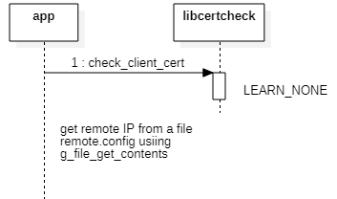
Attack Scenario 1 - Server IP Address stored in Plaintext
Phase 2
Vulnerability:
The server IP written in the remote.config file is plaintext. This file is read during client app initialization.
Attack Scenario (how to test):
Compromising remote.config file
Use ZZUF to compromise remote.config file
Open client application with compromised remote.config file
Attack Result:
Client blocked connections by input validation for IP address (g_hostname_is_ip_address)
Recommended Mitigation:
Store config file in secure storage
Lock server ip address with encryption
$ cat remote.config
192.168.0.100
$ ./zzuf -r0.05 cat remote.config
182.16|.4�1p
ATTACK
$ ./client
2021-06-24T19:49:35.029507 client WARNING not valid ipaddr in remote.config file 182.16|.4\2561p\021
Notes:
The first scenario is attacking the vulnerability that the server IP is written in a file with plaintext.
This vulnerability is easy to attack and it can cause Denial of Service.
So, we tried to compromise config file using ZZUF tool.
You can see the result of broken ip address by ZZUF here. If we use this result to run the client application, the application is terminated by input validations in the initialization procedure that team 6 applied.
Another simple way to exploit plaintext vulnerability is the manual modification of ip address.
the client application is initialized well, but the connection is failed by timeout when we try to login to server, because there is no listening server.
To mitigate this vulnerability, we recommend storing the config file in secure storage, or fixating server ip address with encryption.
----------
첫번째 attack case는, client에서 접속하기 위한 server의 ip가 plaintext로 파일에 저장되어있다는 취약점을 공격하는 것이다.
이 취약점을 공격하는 방법은 두 가지가 있는데, fuzz exercise에서 활용했던 zzuf를 가지고 파일을 손상시키는 것이 있고, 그냥 서버 ip 주소를 바꿔버리는 방식이 있다.
zzuf에 의해 손상된 파일을 가지고 client앱을 실행하면, 초기화 단계에서 6팀이 수행한 ip address에 대한 input validation에 의해 실행이 종료되어, 더이상 서비스를 이용하지 못한다.

Slide 24
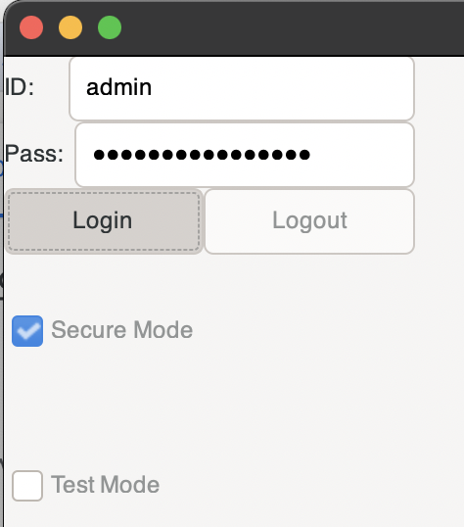
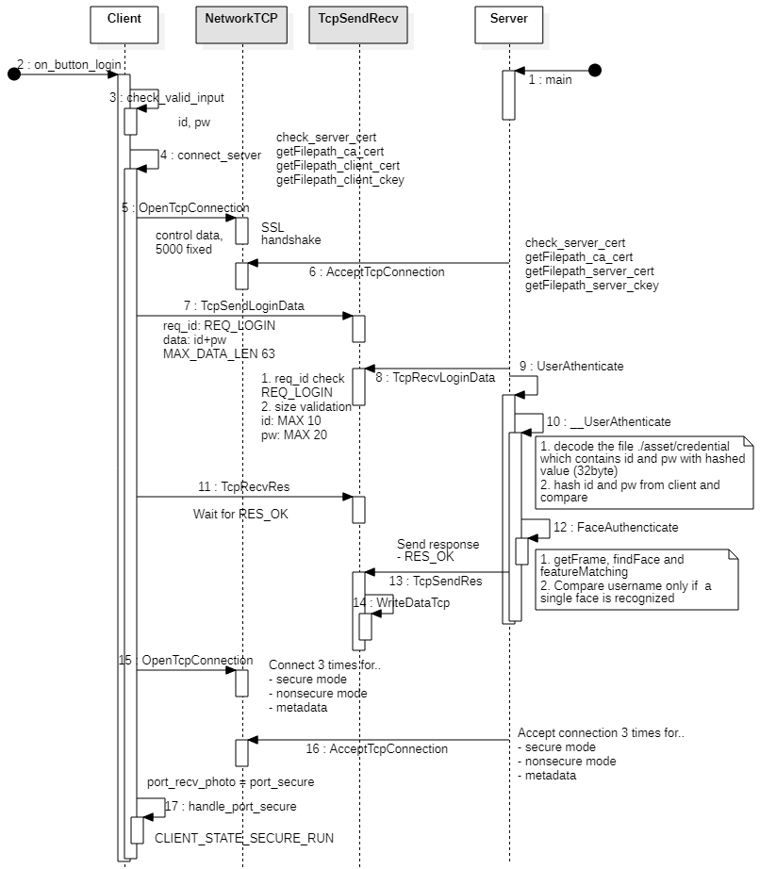
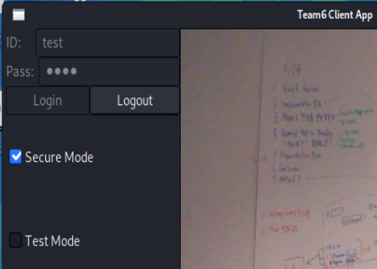
Attack Scenario 2 - Video Sniffing without Authentication
Phase 2
Vulnerability:
Though 4 socket connections are used, the only
first connection has the authentication process.
Attack Scenario (how to test):
Timing Attack (Immediately after normal login of control socket, try to connect 3 socket except for control socket)
Attack Result:
The attacker can sniff the video
Recommended Mitigation:
Use same session key over 4 connection Authenticate every socket connection
w/ Authentication
< normal login >
ATTACK
< attack w/o authentication >
w/o Authentication
Notes:
In this attack scenario, we focused on the connection process between the client and server.
Though 4 socket connections are used, the only first socket connection has the authentication process.
After the first socket connection is established by the normal login process, If an attacker intervenes and establishes the remaining three socket connections, then the attacker can see the video without authentication.
We can mitigate this vulnerability by using a session key or authenticating every socket connection.

Slide 25
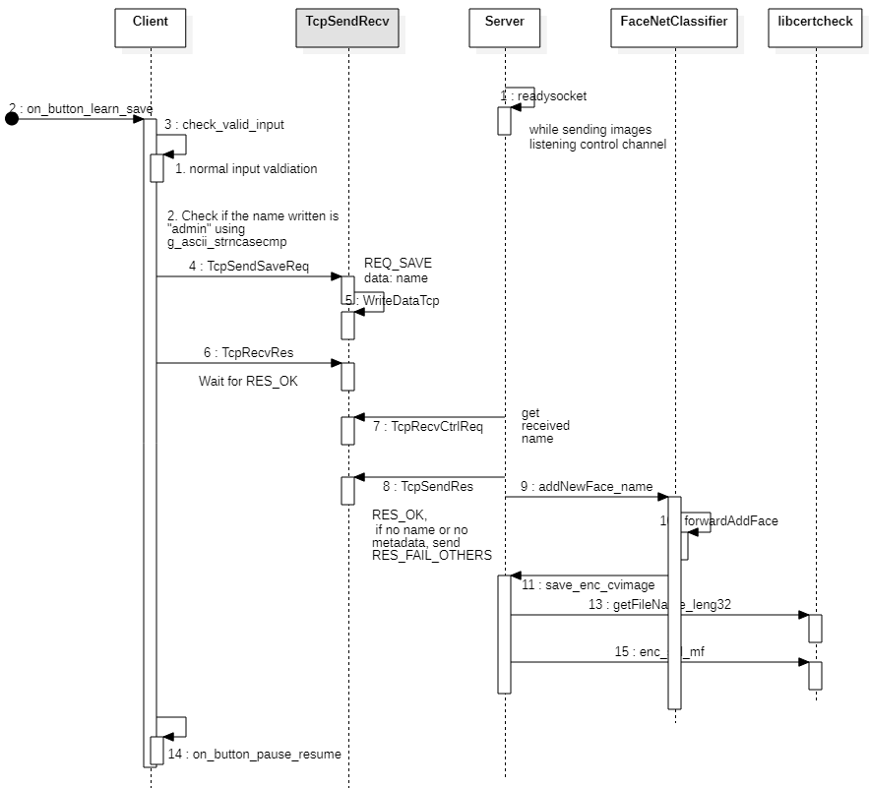
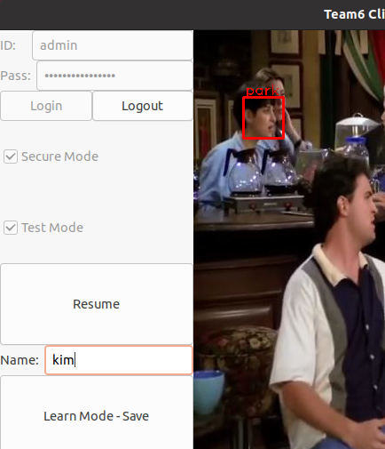
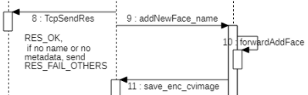
Attack Scenario 3 - A face with Various Names
Phase 2
Vulnerability:
A person can have different names on learning mode
Attack Scenario (how to test):
Save a face to a new name ‘park’
Press pause button when that face is shown and recognized.
Save it with another name ‘kim’
Attack Result:
The same face is recognized alternately with different names ‘park’ and ‘kim’ depending on the conditions such as angle, lighting.
Recommended Mitigation:
Add a logic NOT to allow another name for already recognized face
ATTACK
Notes:
-- 스크립트 확인 --
The third attack scenario is using the vulnerability that the one person can have different names in the system.
We found this issue by code review, and it is easy to reproduce.
We thought this vulnerability could be exploited to other attacks like spoofing.
For example, If a face is already registered as name of Park, Park would be displayed when that person is shown in the image.
This is a normal case.
However, if an attacker presses ‘pause’ button while Park is shown in the image,
a chance to add a new name for the same person is given.
If the attacker request to save a name as Kim, the system registers the face for same person with different names,
then the face is alternatively recognized as Park and Kim, and it makes confusion to users.
To remove this issue, we suggest that the server should have a procedure not to allow the chance to register another name for already recognized face <like what we did on phase 1. We used a field ‘registered’ to distinguish who is registered and sent it to client.>여긴 필요하면 말하는 걸로..

Slide 26
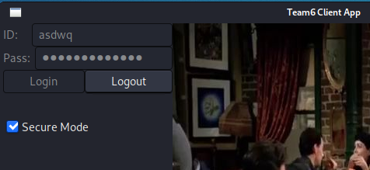
Attack Scenario 4 - Authentication Bypassing
Phase 2
Vulnerability:
ID/PW are checked only one time, so one-block detour enables to avoid authentication
Attack Scenario (how to test):
Disassemble the server software using rizin
Find out the authentication function and modify it to always return true
Attack Result:
Unauthorized users are able to access the system
Recommended Mitigation:
Repeatedly use authentication credentials (e.g., use hashed ID and PW as authentication token and server keeps requesting it for every functionality)
ATTACK
Notes:
The last attack scenario we will introduce is accomplished from reverse engineering.
User ID and password are examined only once, as you can see in the figure.
<CLICK>
So we disassembled the binary using Rizin, and made the authentication function always return True.
As a result,
<CLICK> as you can see,
unauthorized user with invalid ID can access the system and get images.
To mitigate, repeated use of credentials would be good to make the attack difficult.

Slide 27
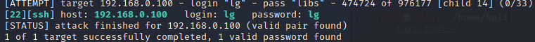
Penetration Test
Phase 2
Vulnerability: Too short and simple User ID and password are easily exploitable
Penetration Method:
Metasploit (FAIL)
Able to exploit Rpcbomb to Rpcbind service (DoS)
Brute-Force SSH Credentials (SUCCESS)
Take up too much time
Proper dictionary would save a lot of time (success probability ↔ running time trade-off) - made assumption that lower-case letters only and short length (20,469 words → 988 words)
Potential risks in consequence of penetration are:
Confidentiality - access to private data (user images and certificates)
Integrity - modify log or program by recompiling or reverse engineering
Availability - break the program of file system
Notes:
We tried two penetration approaches to Jetson Nano server.
The first one is metasploit, but only a DoS attack to RPCBind succeeded, not penetration
So we tried another method, brute force attack.
A vulnerability we all know is that ID and password is too simple.
"lg" for User ID and "lg" again for password.
First we tried a dictionary file containing 20469(twenty-thousand and four hundred sixty nine) words
and found out this attack never meets the deadline.
So we made new dictionary file containing 988 (nine hundred eighty-eight) words
with the password length is less or equal to four
and only the lower-case letters are used, then we were able to find the id and password.

Slide 28
Summary
Phase 2
Analysis of Team 6's security activities
Are there any missing threats? -> Some threats were not derived.
Has the threat been mitigated? -> All derived threats are mitigated.
Did new vulnerabilities arise because of mitigation? -> No.
Did Team 6 mitigate well-known vulnerabilities? -> Team 6 assumed that known vulnerabilities were mitigated due to the tight schedule and focused on looking for new vulnerabilities.
Vulnerability Assessment & Evaluation
We summarized the vulnerabilities we additionally discovered.
We derive the attack scenario, try to attack, and suggest mitigation methods.
Lesson Learned
It is necessary to do these activity to improve security of our system as well.
Notes:
Here is the summary of our activities in phase 2.
We analyzed Team 6’s security activities and found new threats not derived yet.
We summarize the vulnerabilities we additionally found, and derive the attack scenario, try to attack, and suggest mitigation methods.
After phase 2, we realized the importance and necessity of these red team activities. (We have to do this on our system)
----------
괄호안은 빼면 어떨까요? … 그래서 해봤니? 라고 물을 수도 있을 것 같아서요.

Slide 29
Lessons Learned
Notes:
We arrived at the final section.
Let's talk about what we learned while taking this course.

Slide 30
Lessons Learned
Team 5: 5verflow
Proactive security considerations improve security and accelerate the development period.
Communicating the ownership and responsibilities of security processes is essential.
Collaboration between development and security (blue team and red team) results in higher value work.
Various techniques should be utilized to find, evaluate, and mitigate vulnerabilities.
Notes:
Team five got a lot of lessons and they are summarized into four categories.
First, security consideration is not an additional process, should be integrated in the entire development lifecycle. Security issues should be addressed as soon as possible, and be managed consistently.
Second, it is important to communicate the responsibilities of the security process, such as communication with stakeholders, implementation of the special architecture or functions
Third, better collaboration between the blue team and the red team improves the quality of the outcome.
Finally, various techniques should be used, such as code review, dynamic testing for analysis and evaluation,
and multi factor authentication for mitigation.
----------
Original texts in slide
Active communication and dialogue among members is very important for security activities.
Think from the attacker’s perspective: It helps us to know what and how to protect.
Security evaluation and red team activities such as penetration testing are needed
Secure SDL을 따라 해봤다는것에 의미가 있다

Slide 31
Studio Project Phase 2
Team 5: 5verflow
Thank You!
(Q&A)
Notes:
The end of the presentation.
Thank you all for your attention.
Any questions?

Slide 33
Contents
Team Members
Roadmap
Phase 1 Review
Security Development Life-cycle
Requirement
Secure Design
Implementation
Phase 2 Security Evaluation of Classmate’s system (Team 6)
Found Vulnerabilities
Plan
Red Team Activities
Development Process Overview
Analysis of Threat Model
Static Analysis
Sequence Diagram
Attack Scenario
Attack Cases
Penetration Test
Summary
Lessons Learned
Notes:
This is the contents of the presentation.
Phase 1 is also included, but we will move on to Phase 2 quickly. We focus on Phase 2.
I will briefly tell you about the Phase 1, and then we will discuss about Phase 2.

Slide 34
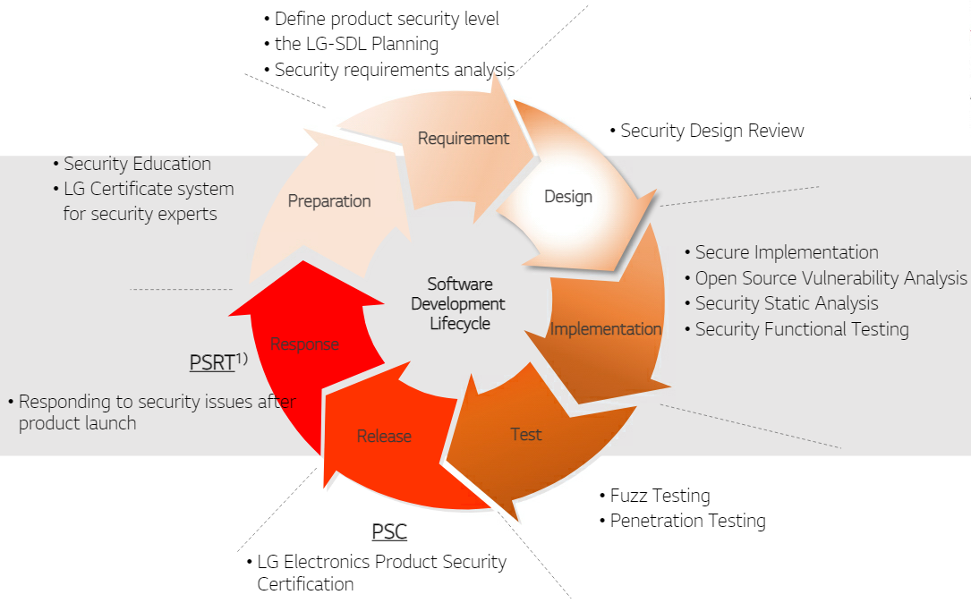
Security Development Life-cycle
Our activity :
User Requirement
Project Requirement
Software Requirement
Security Requirement
Our activity :
Software Architect Design
Quality Attribute
Security Design Review
Our activity :
(Education)
Cousera
MOOC
CMU e-lecture
CMU Live Zoom
Our activity :
Secure Coding
Static Analysis
LG SDL
Phase 2 :
Evaluation of Team 6’s System
Notes:
This diagram shows LG Security Development Life-cycle during the development process.
It is an incremental spiral model and actually it is consistent with what we learned during this course.
It contains all tasks that we learned during this course.
In phase 1, we had processed preparation, requirement analysis, design, implementation.
And remaining parts - testing, release, and responding to security are processed in phase 2.
PSRT - Product Security Response Team
PSC - It finally certifies that LG-SDL security activities have been performed on the product.

Slide 35
Implementation
Phase 1 Review
Client
Qt framework
OpenSSL
Server
OpenSSL
rsyslog
Client UI
Server is always printing the log
<Client>
<Server>
Notes:
We implemented our client and server based on the given sample code.
We use the Qt framework for the client GUI.
OpenSSL is applied to secure transmission between client and server.
rsyslog for server-side logging
it can be used for remote logging of client-side, too. but we didn't have time to apply it.

Slide 36
Implementation & Verification
Phase 1 Review
Secure Coding w/ Static Analysis
FlawFinder : 21 issues found
fixed!
Verifications w/ 20 Test cases
Notes:
After the design phase, we implements our system. During implementation phase, we performed static analysis such as FlawFinder and CppCheck and fix issues before commiting.
For example, every sprintf were replaced with snprintf, and strcpy were replaced with strlcpy.

Slide 37
Team 6 Development Process Overview
Phase 2
Analyzed from Documents
Requirement
Design
Implementation
Test
Secure Mode
2 Factor Authentication
User Credentials
Encrypt data by using TLS/AES/SHA256
Mutual authentication
Input sanitize
Code obfuscation
FlawFinder
CppCheck
9 functional test cases
secure test cases
Vulnerability
Data Exposure
Communication
Comparison with our artifacts
+ Code obfuscation we didn’t
- Secure test cases team 6 didn’t
Goal
Protect PII !
Notes:
artifacts들을 분석을 통해 개발 각 단계에서 논의 된 것으로 보이는 security issue들을 정리해 보았다.
Requirement : 요구 사항을 분석하면서 Secure Mode, 2 FA, User Credentials에 주목했고, 요구사항 도출과정에서 Data Exposure와 Communication이 취약함을 발견, 특히 개인정보를 보호하는 것을 Goal로 지정함. 이후 Threat Modeling하고 STRIDE와 P&G 등의 기법으로 위협을 분석하고 OWASP으로 위험 평가를 수행하여 최종 Security Requirement를 도출
Design : 요구사항 만족을 위해 TLS 및 AES와 SHA256을 이용하여 data flow와 user data를 encrypt하는 design과 mutual authentication및 input sanitize를 적용
Implementation : 역공학을 대비해 코드 난독화 적용하고, flawfinder와 cppcheck을 이용하여 static analysis를 반복 수행하여 secure coding을 준수
Test : 9 개의 Functional TC 수행

Slide 38
Plan of Red Team Activities
Phase 2
plan 필요 없을까요? phase1과 동일한 프로세스를 따랐다 라던가. 우리 strategy는 우리것과 6팀 산출물의 비교 검토에 치중했다 라던가…
⇒ 필요합니다..Organization이랑..
Comparison도 필요할까요?
ex) Requirement에서 6팀은 뭐하고 우리는 뭐했고, 6팀은 뭐에 치중했고, 우리는 뭐에 치중했고 등등??
⇒ 6팀 시스템 간략한 설명은 앞장에 써놓긴 했는데, Document analysis 페이지에 보안적인 측면에서 고려한것들이 보여지면 좋을 것 같습니다.
Schedule
Analyze documents
Threat Modeling
Security Requirement
Design Document
Conduct test cases
Given test cases
Additional exploring test
Code reviews
Write Sequence Diagram
Secure Perspectives
Discuss Attack scenario
Do Attack
based on our vulnerability hypothesis
Wrap Up
Team Organization
Name | Role (Phase 2)
SeungWook Cha | Team Lead
SungJun Lee | Doc. Anal.
DongHyuk Han | Doc. Anal. & Test
WooLam Kang | Impl. Anal. & Test
YooKyoung Choi | Doc. Anal. & Test
YoungJinn Lee | Impl. Anal. & Test
Notes:
Let's go ahead. Now I will explain the detail of our analysis process.
Prior to the analysis, we planned a new schedule and assigned each role for phase 2.
Based on the artifacts received from the team 6, we analyze the documents by comparing them with what we did in phase 1, perform the given TC, and check the vulnerabilities that were suspected in the analysis process. We want to verify whether the mitigation is successfully applied through this task. We also looked for any missing vulnerabilities.
코드 분석으로 얻어낸 Sequence Diagram과 시큐어 관점에서 주요 로직에 대한 코드 리뷰를 수행하고 심도 깊게 취약점을 찾아내려 노력하였다.
발견한 취약점들에 대해 공격 시나리오를 작성하고 공격을 수행하였다.

Slide 39
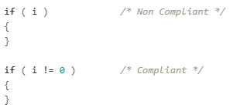
Static Analysis
Phase 2
Analysis to evaluate and recommend mitigations
FlawFinder ID | Sourcecode path (line) | Target | Vulnerability code | Analysis of Team 5
FF-01 | ./common/TcpSendRecv.cpp:124 | (buffer) memcpy | CWE-120 | need mitigation - alloc size of dst
FF-02 | ./common/TcpSendRecv.cpp:129 | (buffer) memcpy | CWE-120 | need mitigation - alloc size of dst
FF-03 | ./common/TcpSendRecv.cpp:466 | (buffer) memcpy | CWE-120 | need mitigation - alloc size of dst
FF-04 | ./server/src/faceNet.cpp:122 | (misc) open | CWE-362 | Follow the principle of least privilege when assigning access rights to entities in a software system. Denying access to a file can prevent an attacker from replacing that file with a link to a sensitive file.
... | ... | ... | ... | ...
FF-08 | ./server/src/main.cpp:163 | (buffer) memcpy | CWE-120 | false alarm
FF-09 | ./common/TcpSendRecv.cpp:99 | (buffer) strlen | CWE-126 | false alarm the parameter userid((const gchar*) is called with c_str() which always contains null termination
... | ... | ... | ... | ...
CppCheck ID | Sourcecode path (line) | Type | Analysis of Team 5
CC-01 | server/src/main.cpp:196 | style [unreadVariable] | false positive
CC-02 | server/src/main.cpp:201 | style [unreadVariable] | false positive
CC-03 | server/src/main.cpp:209 | style [unreadVariable] | false positive
... | ... | ... | ...
CC-07 | server/src/videoStreamer.cpp:35 | warning [noCopyConstructor] | false positive - use openCV library
CC-08 | server/src/videoStreamer.cpp:35 | warning [noOperatorEq] | false positive - use openCV library
CC-09 | server/src/videoStreamer.cpp:60 | style [unusedFunction] | unused. if not in use, delete it.
CC-10 | server/src/common.cpp:22 | style [unusedFunction] | unused. if not in use, delete it.
CC-11 | server/src/faceNet.cpp:414 | style [unusedFunction] | unused. if not in use, delete it.
CC-12 | common/Logger.cpp:110 | style [unusedFunction] | unused. if not in use, delete it.
CC-13 | common/Logger.cpp:124 | style [unusedFunction] | false positive
CC-16 | server/src/videoStreamer.cpp:43 | style [unusedFunction] | unused. if not in use, delete it.
... | ... | ... | ...
<FlawFinder>
<CppCheck>
Top 5 violations
Violated Rules | counts | Rule
cppcheck:misra_c_2012_15_01 | 119 | The goto statement should not be used
cppcheck:misra_c_2012_14_04 | 88 | The controlling expression of an if-statement and the controlling expression of an iteration-statement shall have essentially Boolean type
cppcheck:misra_c_2012_15_05 | 86 | A function should have a single point of exit at the end
cppcheck:misra_c_2012_15_06 | 65 | The body of an iteration-statement or a selection-statement shall be a compound statement
cppcheck:misra_c_2012_12_01 | 59 | The precedence of operators within expressions should be made explicit
<Code x-ray(internal tool in LGE)>
Notes:
6팀에서 수행한 static analysis tool인 FlawFinder와 Cppcheck를 실행하여 vulnerability를 리스팅하고, 각 항목을 평가하여 mitigation이 필요한 부분에 대해 description을 적었다.
추가로, LGE에서 내부적으로 사용하는 static analysis tool인 code x-ray를 이용해보았는데, MISRA standard를 적용하면 500개 이상의 취약점이 나왔음.
MISRA가 Motor Industry가 target이라 safety를 고려해 sensitive하게 체크하는것 같고, MISRA 2012 14.04 rule 처럼 if statement가 boolean형식이 아닌 경우에도 violation으로 검출하는 것을 확인할 수 있었다.
더 tight하게

Slide 40
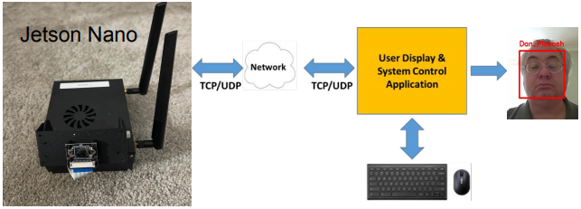
Secure Design - Input Validation
Phase 1 Review
Threat 1 Attacker tries to tamper the data transmitted from Jetson Nano to client program
e.g. invalid image header of JPEG format
Vulnerability 1 Data transmitted from Jeson Nano can be tampered.
Mitigation 1 Check the image format of received data is valid to JPEG.
How to
JPEG header check by parsing SOI (Start of Image) and EOI (End Of Image) bytes which have fixed values.
How to
Checking the input validity while in typing on the edit box of client program and deny input when violate rules
Attack!
Mitigation 2 Application checks if input is valid or not and use functions that restrict the number of bytes
Threat 2 Attacker tries to force the stack overflow using invalid input and inject the executable code. e.g. user name, ip address
Vulnerability 2 Application is implemented with C/C++, which has string functions that are vulnerable to overflow, and do not check input size and format.
Attack!
Notes:
The following 2 slides show some example of our design to mitigate security risk. I will skip for the sake of time.
----------
Let's dive into more detail about our design to mitigate risk.
There are several input items that need to consider verification, such as IP address, User name, and Image data as well.
In the case of threat 1, we assume that attacker can tamper the data transmitted from server to client.
For example, the attacker tampers an image header of JPEG format.
The client cannot decode the image and show it correctly if the header is broken.
We decided to check the header and footer of received image data on the client-side.
And In the case of threat 2, we deny input when the input violates input format rules to prevent malicious user input on the GUI side.

Slide 41
Secure Design - Secure Data Transmission
Phase 1 Review
Threat 1 Attacker connects on the same network and tries sniffing data between Jetson Nano and User Application. Attacker wants to get secure information, e.g. password, or change the data e.g. face data.
Vulnerability 1 Currently, connection is not secure and data is not encrypted.
Attack!
Threat 2 Jetson Nano(server) or User Application(client) might be spoofed by an attacker (SPOOFING) for an unauthorized access.
Vulnerability 2 Neither authenticate each other.
Mitigation 1 Data encryption in transit. TLS is applied for encryption. Ciphersuite : TLS_AES_128_GCM_SHA256
Mitigation 2 Server and Client must mutually authenticate each other. Therefore mutual authentication of TLS is applied.
TLS connection
Applied Technology :
Separate Image and metadata, and include a value ‘Registered’ into metadata for recognized people
Rect
Registered
UserName
Notes:
----------
We also considered secure data transmission.
As we already know, communication over the internet is one of the most vulnerable.
The normal TCP connection is not secure.
They are always exposed to information disclosure and spoofing threats.
So we applied TLS(Transport Layer Security) to secure it.

